Slide 1
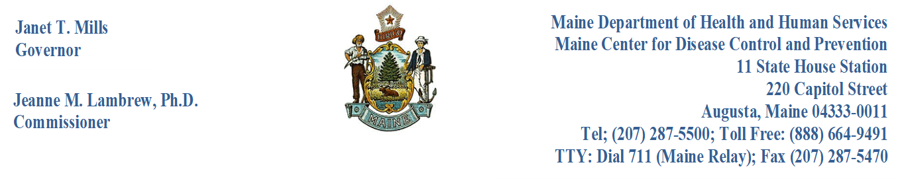
Access and Disclosure of Vital Records

Slide 2

For Your Protection
Vital Records must be safeguarded to protect privacy, personal health information, medical, and other information to deter the commission of fraud and to prevent identity theft. Only those people authorized by the municipal clerk should have access to the vital records filed in your municipality.

Slide 3
Applications
General Section, pages 19-20
When individuals request information about a vital record or a copy of a vital record, the first thing that municipal clerks should require is a completed application or a written request, and proof of identification from the applicant.
Notes:
Applications may be paper or electronic, and they are used to request copies of vital records as well as determine the applicant's eligibility to receive such data or vital records. Upon submission of any application requesting a vital record, the application is then considered part of that record. Municipal clerks must retain all approved applications for at least one year.
Applications may be presented in person, via mail, fax, and e-mail, or electronically when they have been produced by software or the electronic system provided and approved by the Department, such as the DAVE system. Municipal clerks should have applications available in the municipality by providing them on their counters and the municipalities website, if possible. Applications for a vital record may be found on the Department’s public website at https://www.maine.gov/dhhs/mecdc/public-health-systems/data-research/vital-records/order/index.shtml and in the DAVE system under the Forms/Print Forms tab.

Slide 4

Written Requests
General Section, pages 19-20
The applicant's full name, mailing address, telephone number, and email address, or the name of the organization or the official authorized to execute agreements, title, organizational affiliation, mailing address, telephone number, and email address.
Applicant’s relationship to the registrant.
Registrant(s) listed on the record.
Approximate date of the event (or three-year time frame to search).
Place (city or town) of event, if known.
Names of parents of registrant listed on the record, if known.
Notes:
Written requests may be presented instead of an application. The written request should contain at a minimum:

Slide 5

Acceptable Identification of Applicant
General Section, page 20
All applicants must present identification documents at the time of application. The identification documents presented by the applicant must be the original or a copy of a document that has been notarized. Such documentation must be acceptable by the municipal clerk or the Department and shall include:
Government-issued identification that includes a photograph; or
At least two alternate forms of identification; or
An alternative electronic process.
The identification documents provided by the applicant must be notated on the application form or written request. The Department or municipal clerk may verify any identification documents presented with originating agencies if the validity of the identification presented is questionable.
Notes:
A good resource to have on hand is the U.S. ID Checking guide. The guide helps make accurate, on-the-spot verification of driver’s licenses and ID cards to protect against ID fraud. The ID Checking Guide, U.S. & Canada Edition shows every valid driver’s license format in actual size and full color, so fake IDs get stopped cold. Details on territorial documents, federal and military issuance, and consular cards, are also included. For more information, please visit https://www.driverslicenseguide.com/book-us.html.

Slide 6
WHAT IS CONSIDERED A PUBLIC RECORD?
General Section, pages 20-21
Public records. After 75 years from the date of birth for birth certificates, after 50 years from the date of death for fetal death certificates, after 25 years from the date of death for death certificates, after 50 years from the date of marriage for marriage certificates, and after 50 years from the registration of domestic partnerships, any person may obtain noncertified copies of these vital records in accordance with the department's rules. Certificates and records of birth, marriage, and death, including fetal death created prior to 1892 are open to the public without restriction. All persons may purchase a copy on municipal letterhead, or a noncertified copy of a vital record created prior to 1892.
Births | Deaths | Fetal Deaths | Marriage | Marriage Intentions | Domestic Partnerships
After 75 years | After 25 years | After 50 years | After 50 years | After 50 years | After 50 years
Notes:
If the date of the event on the completed application or written request falls in the timeline specified above as a public record, and the identification provided was acceptable, the applicant would be entitled to receive a non-certified copy of that vital record. If the applicant would like a certified copy, the applicant would need to provide a direct and legitimate interest in the record or proof of lineage or relationship.
If the date of the event on the completed application or written request DOES NOT fall in the timeline specified above as a public record (or falls into the category as a restricted vital record specified below), regardless of if the identification provided was acceptable, or if the applicant wants a non-certified copy or a certified copy, the applicant must provide the direct and legitimate interest in the record or proof of lineage or relationship.

Slide 7
Restricted Vital Records
General Section, page 21
Restricted vital records require individuals to complete an application or written request, provide identification, and if the individual is not listed on the record, their direct and legitimate interest in the record, which includes lineage.
Births | Deaths | Fetal Deaths | Marriage | Marriage Intentions | Domestic Partnerships | Abortions | Miscarriages
Before 75 years | Before 25 years | Before 50 years | Before 50 years | Before 50 years | Before 50 years | N/A | N/A
Notes:
Restricted Vital Records. This means vital statistics data, reports, vital records, and reports of abortions, miscarriages, domestic partnerships, and marital intentions presented in conjunction with identifying data or with other information which may allow indirect identification of the registrant or other individuals named on the record. Restricted vital statistics data, reports and records are not public records.

Slide 8

Who Qualifies?
General Section, pages 21-22
Proof of identification is needed for the following applicants:
Self/Registrant, the applicant's record.
Any person(s) listed on the record, either parent, informant, funeral establishment, witness, officiant, etc.
Notes:
Emphasis on informants and parents listed on the record. If a father/parent has a court order naming them as a parent to the record they are requesting, they may obtain a copy. The court order may also be used to add the parent when sent to DRVS along with a $60.00 processing fee which includes a copy of the updated record.

Slide 9
Who Qualifies? (continued)
Proof of identification, a direct and legitimate interest, and/or proof of lineage (or relationship) is needed for the following applicants:
Spouse, (must show marriage certificate)
Registered Domestic Partner, (must show domestic partner certificate)
Guardian, (must show court-issued guardianship papers)
Family, (not on the record), grandparent, siblings, stepparent, stepchild, aunt, uncle, niece, nephew, mother-in-law, father-in-law. (They must show proof of relationship).
Attorney or agent for the person who is the subject of the record. (They must show a notarized statement from the person on record or his/her family and proof of relationship).
A minor’s living/surviving parent is entitled to obtain a death certificate. (Must show the minor’s birth certificate or court order for parental rights and responsibilities).
Genealogists, (must show ID and a valid genealogical researcher identification card).
Others may be approved by the Department by providing supporting documents of eligibility to determine they are qualified to receive such data.

Slide 10

Power of Attorney (POA)
Financial power of attorney. Also called a durable power of attorney for finances, this gives the person of your choice the authority to manage your financial affairs should you become incapacitated.
Medical power of attorney. Also called a durable power of attorney for health care, this gives the person of your choice the authority to make medical decisions for you should you be unable to do so.
Durable Power of Attorney gives the person all the authority as if the person (or subject) is there in person. Example- “I give my cousin, Vinnie, a durable power of attorney and he may do everything I would be able to do, sell my house, close bank accounts, get my birth and marriage certificates as well as my children’s vital records.”
This Photo by Unknown Author is licensed under CC BY-SA
Notes:
Are There Alternatives To A Power of Attorney?
Yes, Guardianship and Conservatorship are alternatives. However, you lose many freedoms and rights under Guardianship or Conservatorship and only a probate court can appoint a Guardian or Conservator.
If you want the court to be able to review your affairs, you might want to have this formal arrangement. However, managing your affairs by either alternative can be accomplished more easily with a Power of Attorney. Remember, a power of attorney, even a durable one, ends when you die. It is not a substitute for a will, so it is a good idea to have both.

Slide 11

Eligibility Matrix
General Section, page 22
Notes:
Copies of the Matrix will be passed out during the training. Discuss different scenarios.
Please visit the Department’s website for more information on who can obtain a certified or non-certified copy of a vital record at https://www.maine.gov/dhhs/mecdc/public-health-systems/data-research/vital-records/edrs/medical-certifiers.html under the Access and Disclosure section. A matrix has been developed to assist municipal clerks in determining eligibility.

Slide 12

Direct and Legitimate Interest
General Section, page 22
Notes:
Flyers will be passed out. The burden of proof falls upon the applicant to present the documentation or lineage that entitles them to obtain a copy of a vital record. Municipal clerks may assist individuals to demonstrate lineage if they have the records on file.

Slide 13

Documents to Demonstrate Lineage
General Section, pages 22-23
Certified copies of vital records presented to demonstrate lineage or relationship are considered the primary documents. The registrant who is 18 years of age or older may present a notarized report of results of DNA testing as an acceptable primary document to obtain a vital record of a parent who is not named on the registrant’s birth certificate.
Notes:
In the event the primary documents to demonstrate lineage or relationship to the registrant specified above are not available, then two documents as specified below shall be presented:
A hospital or physician’s record of birth or death.
A baptismal record.
School enrollment records.
Military records.
Court records.
A U.S. Census enumeration record; or
Other supporting documents approved by the State Registrar.
A municipal clerk or the Department may verify the authenticity of the documents presented in the event they have reasonable cause to question the validity or accuracy of the document.

Slide 14
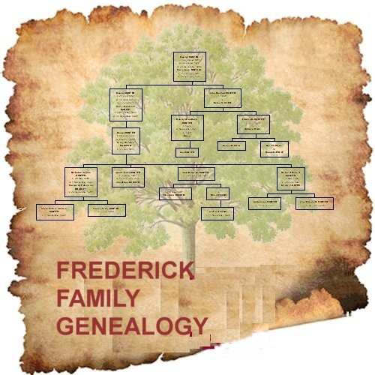
Genealogical Research
General Section, pages 23-24
Genealogical researchers who hold a valid genealogical researcher identification card are entitled to receive non-certified copies of vital records. A registered genealogist may request up to three (3) records per week at no cost from the Department. Information on how to obtain a genealogical researcher card, code of ethics, and paper-based researcher request forms are provided on the website.
Genealogical researchers who request a certified copy must present a completed and signed application or written request, identification, and payment as well as demonstrate a direct and legitimate interest (see pamphlet) in the data, reports, and vital records.
Notes:
Copies of the genealogy card will be passed around. Records before 1820 do not reside in Maine, they reside in Massachusetts. Genealogical researchers looking for these records must contact the State in which the records are housed and comply with that State’s laws, rules, and policies regarding accessing vital records. If a municipality house records before 1820 non-certified informational copies may be issued.
Hours of Operation. Municipalities may want to specify the specific hours during which genealogists may be physically present at the office to request records and the number of requests permitted per visit (e.g., two requests may be made at the counter; additional requests must be submitted in writing, and include the appropriate payment; which may be submitted in person or by mail.) Resources for Genealogical Research may be found on page 24 in the general section of the municipal clerk’s handbook.

Slide 15
Address Confidentiality Program
General Section, page 24-25
Secretary of State (SOS) rules, 29-250, Chapter 900, specify that an individual who is certified as a program participant in the Address Confidentiality Program is issued a program participant’s authorization card. The authorization card includes their name, authorization code, designated address, certification expiration date, and voter code. The card is valid for four years.
Program participants can request (at the time of the creation of a new record) that an agency use the designated address assigned by the SOS as their residential or mailing address by showing the program participant authorization card.
The program participant’s authorization card will always designate 48 State House Station, Augusta, Maine 04330 as the participant’s legal residence, and access to vital records may be further restricted or put on hold to prevent issuance to anyone other than the participant.
Please reach out to Nicole Ladner, Special Project’s Director with the Secretary of State’s office at (207) 626-8407 or nicole.ladner@maine.gov with any questions related to the ACP program.
Notes:
Program participants who are planning to give birth must present the program participant’s authorization card to the facility. The health and medical worksheets completed at the facility must match the designated address assigned on the program participant’s authorization card.
Program participants who are planning to get married must present the program participant’s authorization card to the municipality of residence designated on the authorization card. If the other party to the marriage resides in a different municipality, they may file their marriage intentions in that municipality upon presentation of the program participant’s authorization card. The marriage intentions, marriage license, and certificate must match the designated address assigned on the program participant’s authorization card.

Slide 16
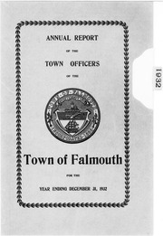
Annual Town Reports
General Section, page 25
It is unlawful for any employee of the State or of any municipality in the State to disclose data contained in such records, except as authorized in this section and except that a clerk of a municipality may cause to be printed in the annual town report the births reported within the year covered by the report, by number of births and location by city or town where the birth occurred, deaths reported within the year covered by the report, by date of death, name, age, and location by city or town where the death occurred, and marriages reported within the year covered by the report by names of parties and date of marriage. All other details of birth, marriage, divorce, or death may not be available to the public, except as specified in department rules.

Slide 17

Recommended Phone Policy
General Section, page 25
Information on a vital record should never be verbally disclosed over the phone, regardless of whether the record is considered public or restricted. Individuals requesting the information must be deemed eligible before receiving any information about a vital record. Regulations require individuals to submit an application or a written request, identification, and when applicable, their direct and legitimate interest (or lineage) in the record requested.
A municipal clerk must not disclose personally identifiable information contained in vital records or issue a copy of all or part of any such record unless the applicant is authorized to obtain such record for a proper purpose or is authorized to obtain such data.
Notes:
Individuals requesting data or information contained in the annual town report should be referred to the municipality’s website or a printed version of the annual report.
Individuals requesting data or information from a public vital record should be encouraged to complete an application to obtain a non-certified copy of the vital record in question.
Researchers engaged in genealogical research who hold a valid researcher identification card should be encouraged to complete an application to obtain a non-certified copy of the vital record in question.
Municipal clerks may use their discretion if or when verifying a vital record is filed within their municipality.

Slide 18
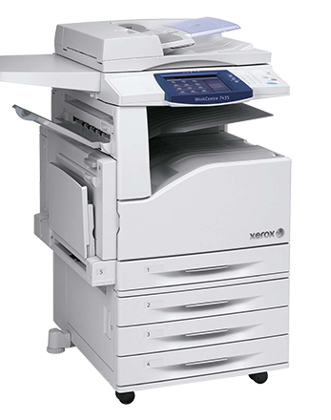
How to Issue Copies of Vital Records
General Section, page 26
A non-certified copy is a copy of a vital record is issued onto blank white paper. The copy must be stamped or marked “NOT TO BE USED AS A LEGAL DOCUMENT”. Generally, non-certified copies are used for investigative research or genealogical purposes only.
A non-certified copy of a public vital record may be issued to applicants who complete an application or written request, present identification, and pay the required fee.
A non-certified copy of a restricted vital record may be issued to applicants who complete an application or written request, present identification, pay the required fee, and provide proof of lineage or their direct and legitimate interest in the record. Individuals named on the record need only to complete an application or written request and present identification.

Slide 19
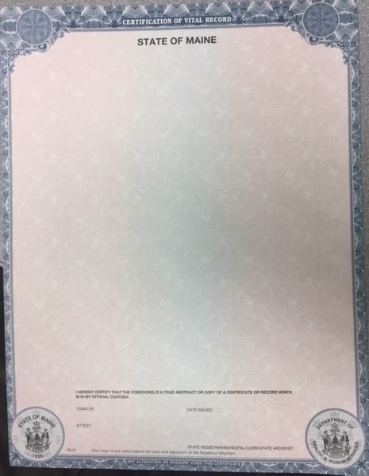
How to Issue Copies of Vital Records
General Section, page 26
A certified copy is a copy of a vital record issued onto safety paper (VS-31). The safety paper is specially created with security measures with raised borders, prismatic type, and other safeguards against fraudulent copying.
Certified copies are considered for all purposes the same as the original and shall be prima facie evidence of the facts stated in the record.
A certified copy of a public or restricted vital record may be issued to applicants who complete an application or written request, present identification, pay the required fee, and provide proof of lineage or their direct and legitimate interest in the record. Individuals named on the record need only to complete an application or written request and present identification.
Notes:
Discuss how to copy the original record to the safety paper and describe how some vital records such as death and marriages may need to be reduced to fit. Seal and signature placement is described in a few slides.

Slide 20
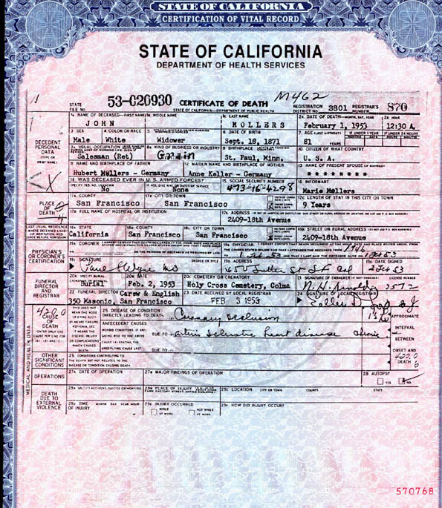
Safety Paper
General Section, pages 26-27
Please ensure the following guidelines are met:
When safety paper is delivered to a municipality from the Department, an authorized person from the municipality will verify that the number of documents received was the number of documents ordered and expected. Any discrepancies or evidence of damaged documents will be reported to the Department or voided in DAVE.
All safety paper will be stored in a locked environment.
Certification equipment items (e.g., embossers, signature stamps, etc.) will also be secured in a locked environment.
Only designated personnel will have access to the locked environment containing safety paper and equipment items used to certify a document.
Two authorized personnel will be present when safety paper and certification equipment items are removed from or returned to the locked environment.
To the extent possible, all printing and copying of records will be done in a single secure location under the control of a supervisor or designated person.
All voided certification of documents will be logged and crosschecked by a supervisor and destroyed by shredding or burning. A record of the serial numbers of voided documents will be saved for audit purposes or recorded in DAVE.
All unused certification of documents will be unloaded from the printer or copier at the end of the day and returned to the locked environment.
The usage of safety paper will be audited. Activity logs will be maintained until the audit is complete. Supervisors and managers will conduct random, unannounced audits of their staff and equipment to verify compliance.
All safety numbers used to issue certified copies of vital records will be recorded on applications or written requests if the numbers are not recorded in the DAVE system. Applications or written requests must be retained for one year.
Notes:
Live demo on assigning safety paper in DAVE on day two.
Assigning Safety Paper in DAVE. The Department highly recommends that all safety paper received be entered into the DAVE system regardless of if the safety paper is used to issue paper vital records (legacy records) or vital records issued from the DAVE system. Any voided or misprinted records must be recorded in the DAVE system for consistency and security reasons. Please refer to the instructions on how to assign and void safety papers in the DAVE system on the Department's website for clerks at https://www.maine.gov/dhhs/mecdc/public-health-systems/data-research/vital-records/edrs/medical-certifiers.html.

Slide 21

Ordering Safety Paper
General Section, page 27
It is the responsibility of the municipal clerk to ensure there is a stock of safety paper on hand to serve their residents. Orders for safety paper must be done by completing the Requisition for VS-31 Blank Safety Paper which may be found in the DAVE system under the Forms/Print Forms tab. Completed forms may be e-mailed to EDRS.DHHS@maine.gov or faxed to (207) 287-2681.

Slide 22
Issuing Non-Certified or Certified Copies of Vital Records (1892 to Present)
General Section, page 28
Preparing non-certified or certified copies should not be a complicated process. It simply involves locating the record either from the municipality vault or in the DAVE system, masking or redacting the mother/parent marital status as well as any statistical, medical, or health information on any paper records, and photocopying or printing the record onto plain white paper (non-certified) or the official blank safety paper (VS-31, certified).
Each certified copy issued must be certified as a true copy or abstract by the officer in whose custody or possession the record is entrusted and shall include the date the copy is issued, the name (typewritten or printed) of the issuing officer, the issuing officer’s signature, or an authorized facsimile thereof, and the seal of the issuing office.
Notes:
Birth records for a foreign-born child may be copied onto blank safety paper (VS-31). Death certificates that have a Supplemental Cause of Death (SCOD) attached must have a copy of the SCOD issued on safety paper when copy of the death certificate is issued. This is considered part of the record and issued at no additional fee. The two pages will be photocopied onto blank safety paper (reduce the photocopy of the original document to fit on the page, 74% for letter size, 62% for legal size ).

Slide 23

Municipal Seal Placement and Certification
General Section, page 28
The signature of the municipal clerk, appointed deputy, or assistant clerk, and the municipal seal on a certified copy or abstract of a record is a guarantee that it is a correct and authentic copy. Proofread all copies carefully. If errors are made, destroy the copy, and start over. There must not be any strikeovers, erasures, correction fluid, or tape, on a certified copy.
Certify the copy with the issuing clerk’s signature and typewritten or printed name and title, the date the copy is issued, and the municipal raised seal. Each municipality should have a municipal seal for use in making certifications. The municipal seal should be placed near the bottom of the certified copy but should not cover the signature or date issued to ensure the information completed by the issuing clerk is legible on any certified copy issued.
Notes:
Fake safety paper will be passed around. An ink signature is preferable, but a facsimile signature (rubber stamp) may be used to facilitate the process in offices where the municipal clerk or deputy clerk may not always be present. In situations when a facsimile signature is used, the person issuing the copy should put their initials next to the stamped signature. Protect all municipal stamps and seals against unauthorized use by securing them in a locked location, along with safety paper.

Slide 24
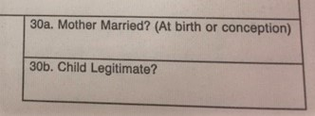

Masking Information on Paper Records
General Section, pages 28-29
Certain paper-based records have a section marked “For Medical and Health Use Only”, “For Statistical Purposes Only”, “Confidential: This Information Will Not Appear on Certified Copies of the Record,” etc.
Municipal clerks should always redact or mask this section before photocopying the record. The data in this section is for statistical use only and must not appear on copies. Some records have a section marked “Confidential Medical Information”; this should be masked except when making copies for a person who can demonstrate a direct and legitimate interest in the record. The marital status of the mother on a birth certificate must be masked and must not appear on any copy (certified or non-certified).
Notes:
This information may show on a non-certified copy only if requested by the applicant.

Slide 25
Abstracts
General Section, page 29
VS-10 VS-20 VS-30
Try to avoid issuing abstracts of vital records if the original record is available to be photocopied Abstracts will typically need to be issued for vital records occurring from 1892 to 1955 when clerks mostly recorded vital events in ledger books and before the Department changed the format and reporting process in 1956.
Notes:
When typing an abstract, please be sure to enter the data or information exactly as it appears on the original vital record. In the event an amendment or correction has been done to a vital record, please remember to include any amendments/correction notations (or deceased watermarks) that appear on the original record. Please feel free to contact the Department with any questions.

Slide 26

Redacting Information
General Section, pages 29-30
On occasion, a municipal clerk may be asked to “leave off or mask” the cause of death section or the social security number on a death record or information on other vital records. These types of requests from entitled individuals are reviewed on a case-by-case basis and are done only by typing an abstract.
The data or information requested to be left off, masked, or redacted on an abstract must contain chevrons <<<<<<<>>>>>>>> to be consistent with the electronic registration systems, if or when data on a vital record is missing. The abstract must then be copied onto safety paper (VS-31).

Slide 27
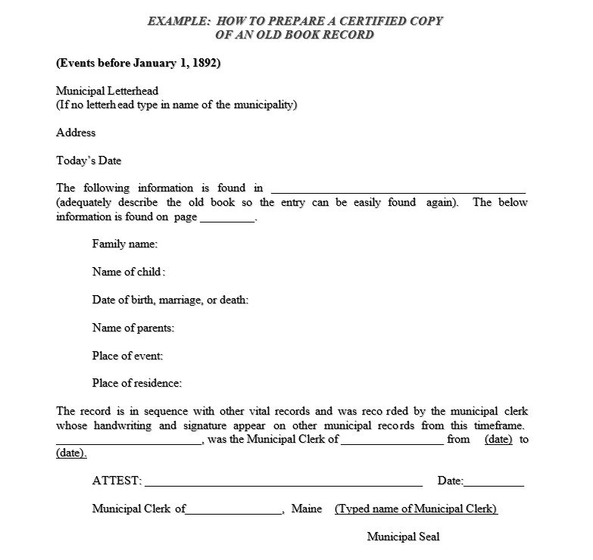
Issuing Copies of Records Prior to 1892
General Section, pages 30-31
Notes:
Certificates and records of birth, marriage, and death, including fetal death, created prior to January 1, 1892, are open to the public without restriction. All persons may purchase a copy on municipal letterhead, or a noncertified copy of a vital record created prior to 1892. "Hands-on" access or inspection of original, paper-based records or indexes shall not be permitted if there is an alternative method that may be used.
Older records prior to 1892 may have no date of filing and most times there is no indication as to whom entered the record in the ledger book. When duplicating a record from an old er book, please keep the following in mind:
Copy the information verbatim as it appears on the record. Do not leave out or add a single letter even if there are obvious errors that anyone can recognize.
Describe the book (title) which contains the record and give the page number of the record.
If the record does not provide a date of filing, enter the month and year.
Never issue records occurring before 1892 on safety paper or use the VS-10, VS-20, or VS-30 abstract form. Please see the example below for issuing records occurring prior to 1892.

Slide 28
Issuing Copies of Birth Records Marked Deceased
General Section, pages 31-32
To protect the integrity of vital records and to prevent the fraudulent use of birth certificates of a deceased person, the DAVE system was developed to match birth and death certificates for persons less than 45 years of age and post the facts of death to the appropriate birth certificate. The notation “died or deceased” and the date of death must be entered on the certificate in such a way as to become a part of any copy issued.
Municipal clerks also have the option to prepare a birth abstract (VS-10). The VS-10 abstract is a form-fillable template and is located in the DAVE system under the Forms/Print Forms tab.
Municipal clerks must enter the birth certificate information on the VS-10 exactly how it appears on the birth record. The notation “died or deceased” and the date of death must be entered on the abstract. A fillable field has been added to the VS-10 for this purpose, as well as any amendments that may have been made to the record. Always double-check the typed abstract before copying the VS-10 onto blank safety paper (VS-31) when issuing certified copies.

Slide 29

Fees
General Section, page 33
Title 30-A §2652 regulates the municipal fee schedule. The Department fees are set by regulation and may vary from the municipal clerk fees.
The fees that municipal clerks charge for locating and making certified copies of vital records are specified by the law.
Certified copies of a vital record are $15.00 for the first copy and $6.00 for each additional copy provided at the same time.
Permit for the disposition of human remains $ 20.00, except that a fee is not owed if the disposition of human remains is paid for through the municipal general assistance program.
Recording marriage intentions and issuing a marriage license, is $40.00, except, when the laws of this State require 2 licenses, the fee is $20.00 each.

Slide 30

Questions?

